Slide 1


Computational Structures in Data Science
Lecture 5: Recursion
UC Berkeley EECS Adj. Ass. Prof. Dr. Gerald Friedland
February 25, 2019
http://inst.eecs.berkeley.edu/~cs88

Slide 2
Administrative Issues
Midterm Next Week!
7-9pm, Dwinelle 155

Slide 3
Computational Concepts Toolbox
Data type: values, literals, operations,
e.g., int, float, string
Expressions, Call expression
Variables
Assignment Statement
Sequences: tuple, list
indexing
Data structures
Tuple assignment
Call Expressions
Function Definition Statement
Conditional Statement
Iteration:
data-driven (list comprehension)
control-driven (for statement)
while statement
Higher Order Functions
Functions as Values
Functions with functions as argument
Assignment of function values
Higher order function patterns
Map, Filter, Reduce
Recursion
Notes:
z = 1,2
x,y = 3,4
a,b = z

Slide 4
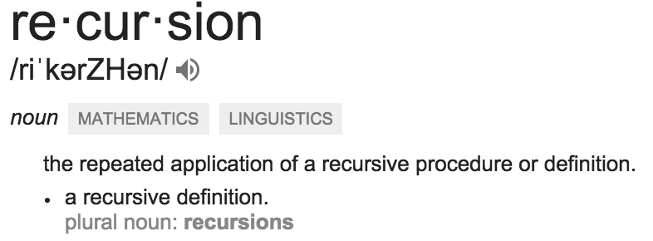
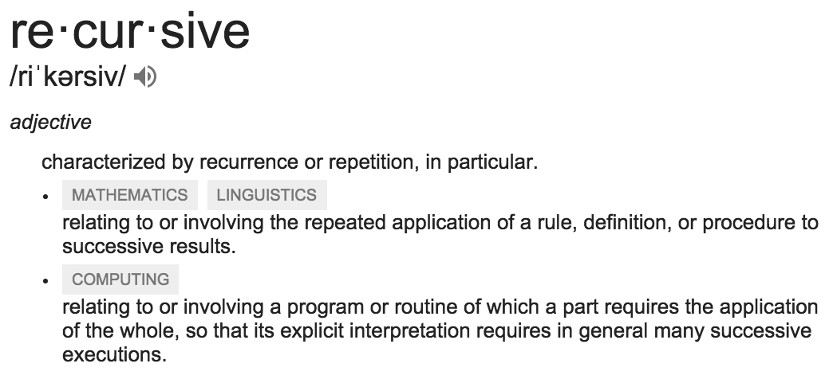
Today: Recursion
Recursive function calls itself, directly or indirectly

Slide 5
Why Recursion?
“After Abstraction, Recursion is probably the 2nd biggest idea in this course”
“It’s tremendously useful when the problem is self-similar”
“It’s no more powerful than iteration, but often leads to more concise & better code”
“It embodies the beauty and joy of computing”

Slide 6
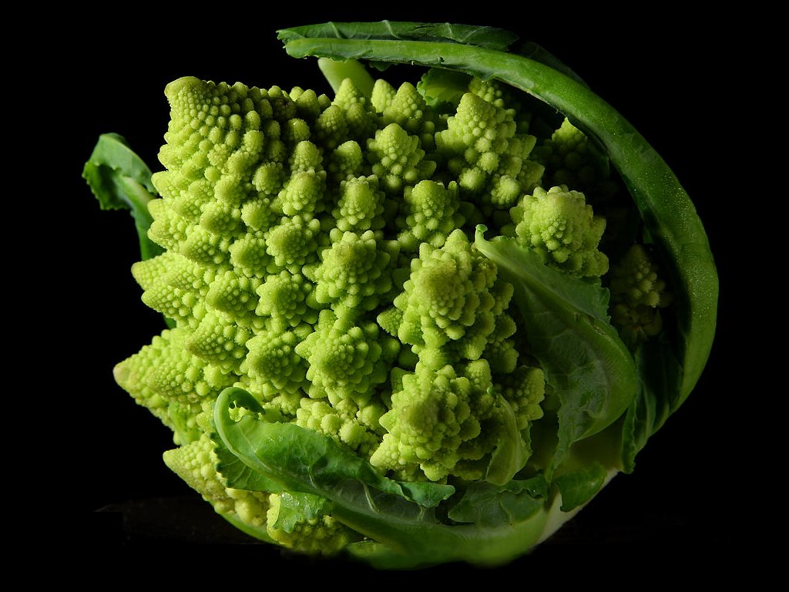
Why Recursion? More Reasons
Recursive structures exist (sometimes hidden) in nature and therefore in data!
It’s mentally and sometimes computationally more efficient to process recursive structures using recursion.

Slide 7
Function Review
A function cannot… A) have a function as argument B) define a function within itself C) return a function D) call itself E) None of the above.
Solution: E) A, B, C, D are all possible!

Slide 8
Recall: Iteration
1. Initialize the “base” case of no iterations
2. Starting value
def sum_of_squares(n):
accum = 0
for i in range(1,n+1):
accum = accum + i*i
return accum
3. Ending value
4. New loop variable value

Slide 9
Demo Time
Vee a randomly recursive fractal

Slide 10
Recursion Key concepts – by example
1. Test for simple “base” case
2. Solution in simple “base” case
def sum_of_squares(n):
if n < 1:
return 0
else:
return sum_of_squares(n-1) + n**2
3. Assume recusive solution to simpler problem
4. Transform soln of simpler problem into full soln

Slide 11
In words
The sum of no numbers is zero
The sum of 1² through n² is the
sum of 1² through (n-1)²
plus n²
def sum_of_squares(n):
if n < 1:
return 0
else:
return sum_of_squares(n-1) + n**2

Slide 12
Why does it work
sum_of_squares(3)
# sum_of_squares(3) => sum_of_squares(2) + 3**2
# => sum_of_squares(1) + 2**2 + 3**2
# => sum_of_squares(0) + 1**2 + 2**2 + 3**2
# => 0 + 1**2 + 2**2 + 3**2 = 14

Slide 13
How does it work?
Each recursive call gets its own local variables
Just like any other function call
Computes its result (possibly using additional calls)
Just like any other function call
Returns its result and returns control to its caller
Just like any other function call
The function that is called happens to be itself
Called on a simpler problem
Eventually bottoms out on the simple base case
Reason about correctness “by induction”
Solve a base case
Assuming a solution to a smaller problem, extend it

Slide 14
Questions
In what order do we sum the squares ?
How does this compare to iterative approach ?
def sum_of_squares(n):
accum = 0
for i in range(1,n+1):
accum = accum + i*i
return accum
def sum_of_squares(n):
if n < 1:
return 0
else:
return sum_of_squares(n-1) + n**2
def sum_of_squares(n):
if n < 1:
return 0
else:
return n**2 + sum_of_squares(n-1)

Slide 15
Tail Recursion
All the work happens on the way down the recursion
On the way back up, just return
def sum_up_squares(i, n, accum):
"""Sum the squares from i to n in incr. order"""
if i > n:
return accum
else:
return sum_up_squares(i+1, n, accum + i**2)
>>> sum_up_squares(1,3,0)
14
Base Case
Tail Recursive Case

Slide 16
Local variables
def sum_of_squares(n):
n_squared = n**2
if n < 1:
return 0
else:
return n_squared + sum_of_squares(n-1)
Each call has its own “frame” of local variables
What about globals?
https://goo.gl/CiFaUJ

Slide 17
Iteration vs Recursion
For loop:
def sum(n):
s=0
for i in range(0,n+1):
s=s+i
return s

Slide 18
Iteration vs Recursion
Recursion:
def sum(n):
if n==0:
return 0
return n+sum(n-1)

Slide 19
For Homework
fibonacci(n) = fibonacci(n-1) + fibonacci(n-2)
where fibonacci(1) == fibonacci(0) == 1

Slide 20
Another Example
indexing an element of a sequence
def first(s):
"""Return the first element in a sequence."""
return s[0]
def rest(s):
"""Return all elements in a sequence after the first"""
return s[1:]
def min_r(s):
“””Return minimum value in a sequence.”””
if len(s) == 1:
return first(s)
else:
return min(first(s), min_r(rest(s)))
Slicing a sequence of elements
Base Case
Recursive Case
Recursion over sequence length, rather than number magnitude

Slide 21
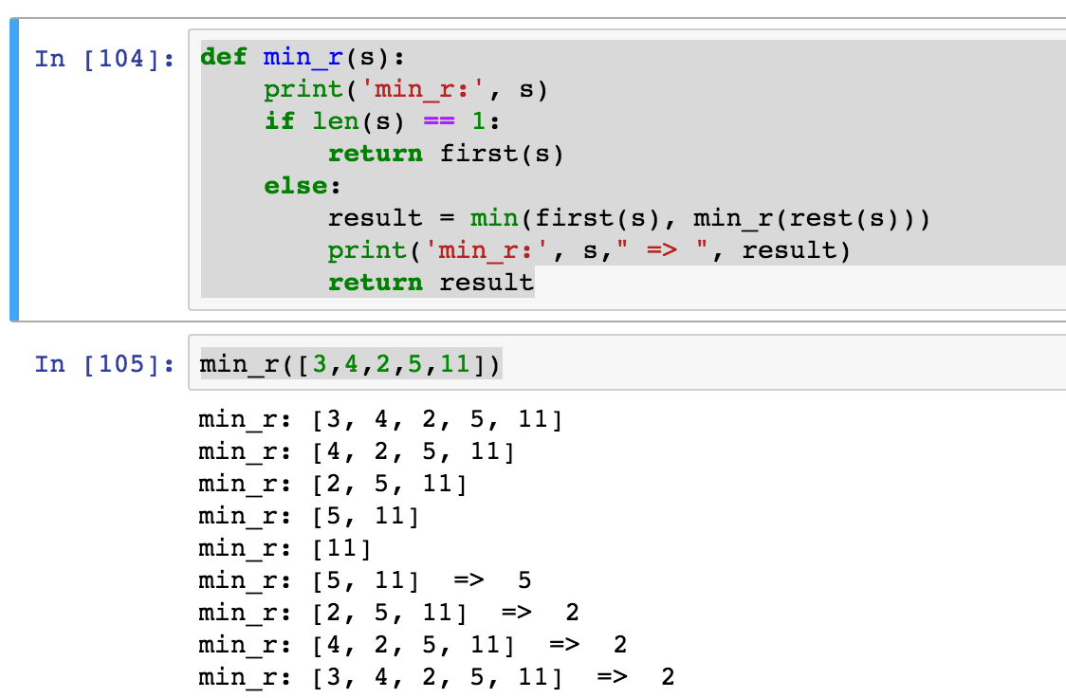
Visualize its behavior (print)
What about sum?
Don’t confuse print with return value

Slide 22
Trust …
The recursive “leap of faith” works as long as we hit the base case eventually
What happens if we don’t?

Slide 23
Recursion
Recursion is…
A) Less powerful than a for loop B) As powerful as a for loop C) As powerful as a while loop D) More powerful than a while loop E) Just different all together
Solution: C) Any recursion can be formulated as a while loop and any while loop can be formulated as a recursion (with a global variable).

Slide 24
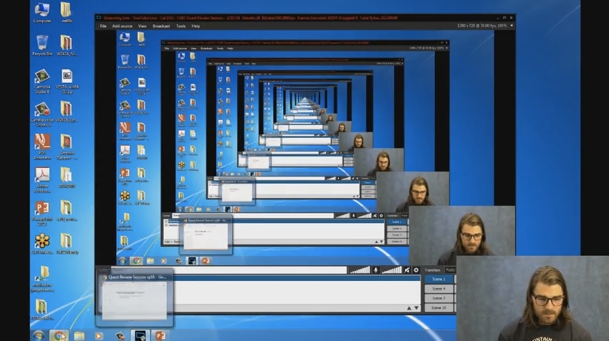
Recursion (unwanted)

Slide 25
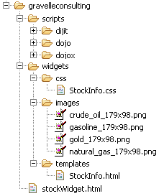
Example I
List all items on your hard disk
Files
Folders contain
Files
Folders
Recursion!

Slide 26
List Files in Python
def listfiles(directory):
content = [os.path.join(directory, x) for x in os.listdir(directory)]
dirs = sorted([x for x in content if os.path.isdir(x)])
files = sorted([x for x in content if os.path.isfile(x)])
for d in dirs:
print d
listfiles(d)
for f in files:
print f
Iterative version about twice as much code and much harder to think about.

Slide 27
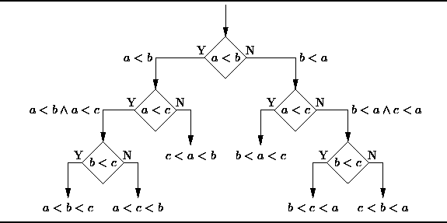
Example II
Sort the numbers in a list.
Hidden recursive structure: Decision tree!

